Slide 1
Angio-based QFR Virtual PCI versus Conventional Angio-guided PCI in the achievement of an optimal post-PCI QFR:
the AQVA trial

Slide 2
Why this study?
Wire based post-PCI physiology can predict outcome but is rarely utilized in clinical practice¹.
The inherent limit of post-PCI physiology is the increase of procedural time, radiations, contrast-dye and costs². Thus, a broad application of post-PCI physiology, although clinically meaningful, is implausible.
The systematic application of Angio-based FFR before stenting to simulate PCI results (virtual PCI) would be an interesting alternative to achieve a fully physiology guided procedure.
No randomized trial tested this strategy versus an angio-guided PCI.
1. Biscaglia S, JACC Cardiovasc Interv. 2021;14:237-246. 2. Collison D, Eur Heart J. 2021;42:4656-4668.

Slide 3
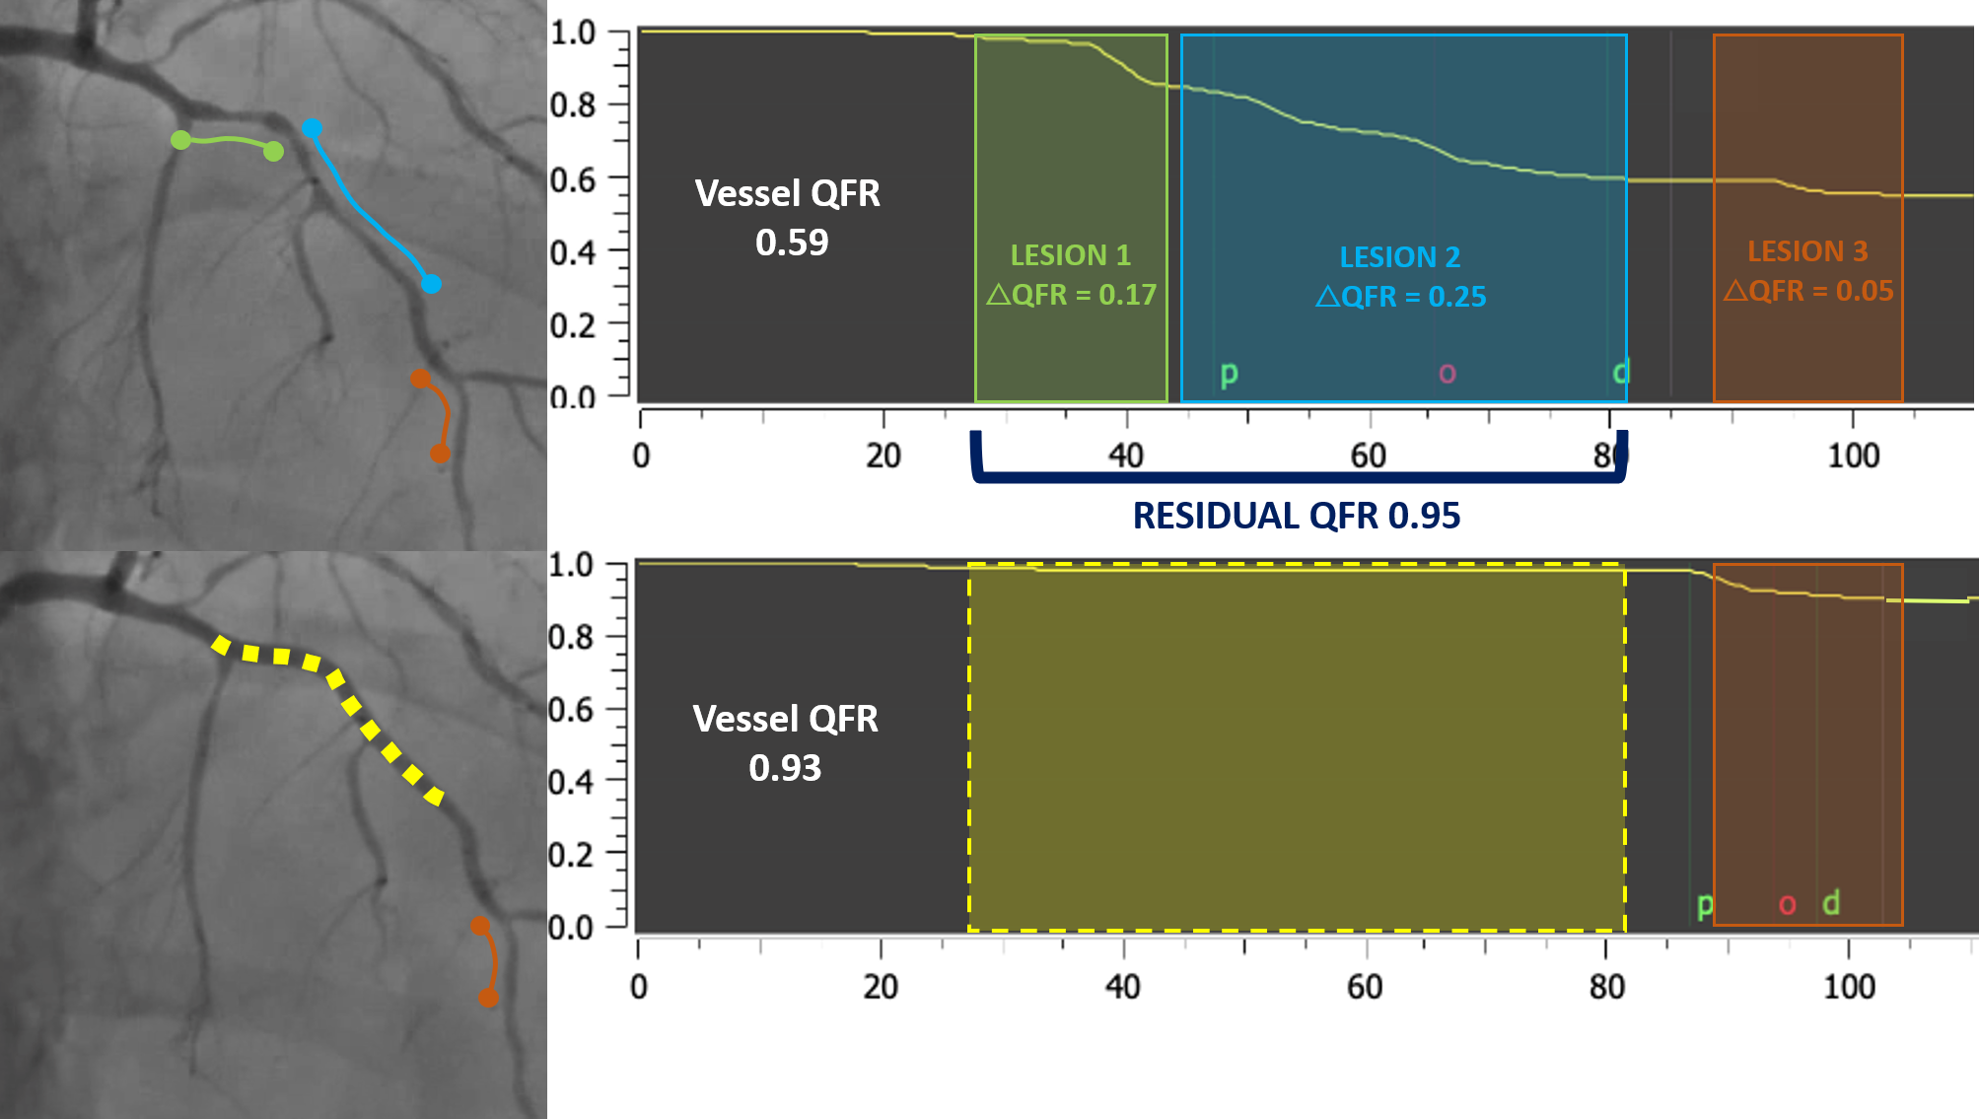
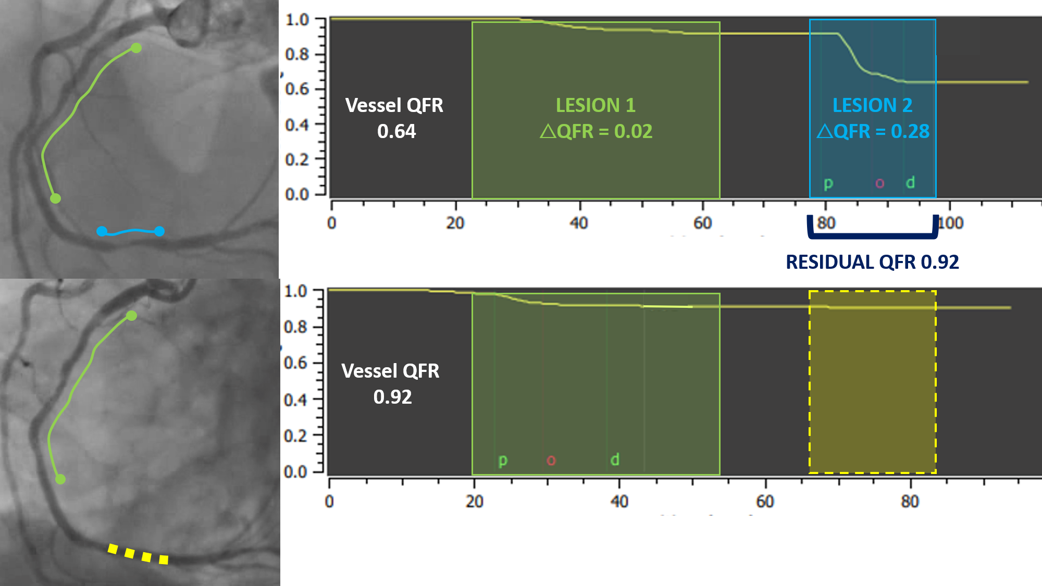
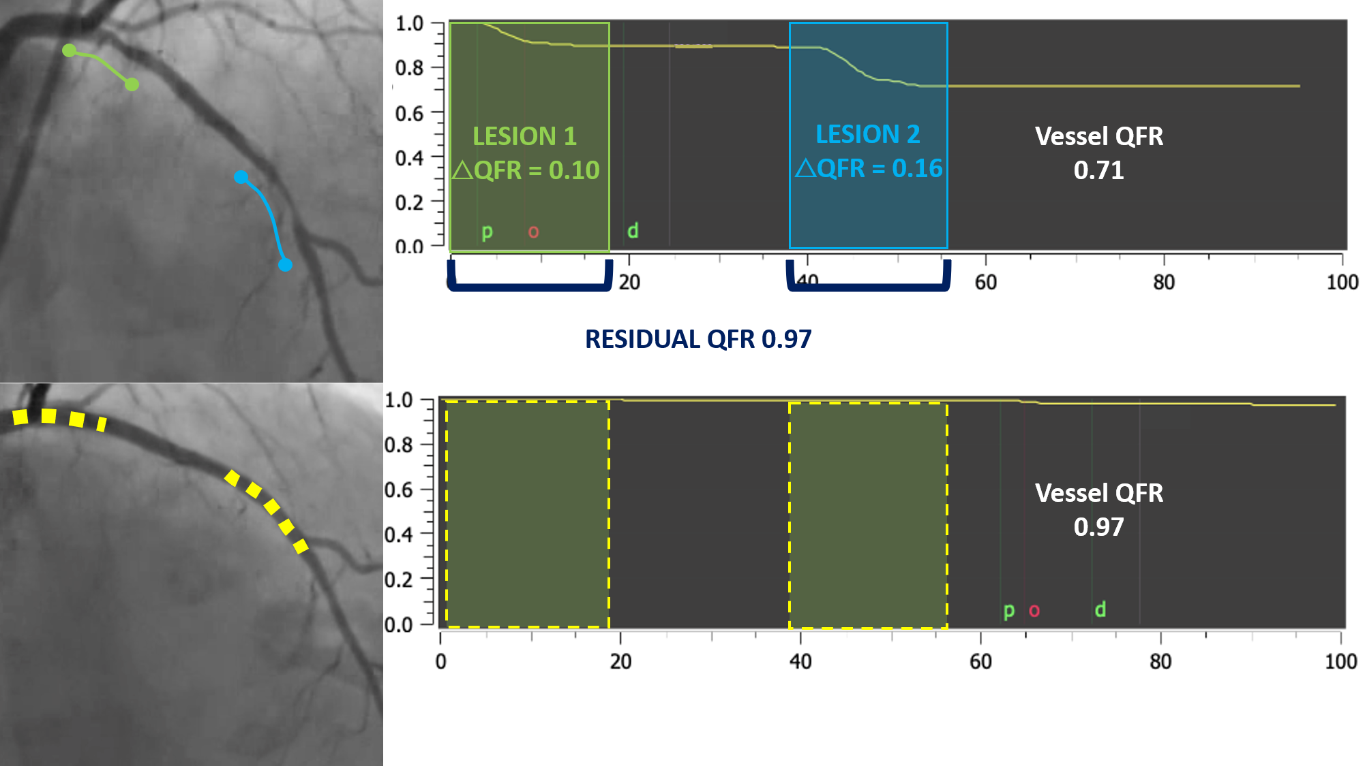
Why this study?
How does QFR-based virtual PCI work?
QFR projections
QFR pullback
QFR plan to obtain post-PCI QFR≥0.90
Leave focal lesion
Leave diffuse disease
Treat serial lesions

Slide 4
What did we study?
Hypothesis: a Quantitative flow ratio (QFR)-based virtual PCI plan is superior to angio-based PCI in obtaining an optimal post-PCI physiological result defined as a blinded post-PCI QFR ≥0.90

Slide 5
How was the study executed?
Design: a prospective, multicenter, investigator-driven, randomized, controlled, parallel group clinical trial.
Follow-up data will be reported separetely
The inclusion of patients with lesion length <20 mm was discouraged
Randomization was stratified by clinical presentation (ACS vs CCS) and LAD involvement.
SAMPLE SIZE CALCULATION:
Angio-guided PCI: 16% of lesions with post-PCI QFR <0.90¹
33% of these lesions: diffuse disease¹
Estimated reduction with virtual PCI plan: 60%
300 patients are required to have a 80% chance of detecting, as significant at the 5% level, an increase in the percentage of patient achieving a post-PCI QFR≥0.90 from 84% in the angio-guided group to 94% in the virtual PCI group
1. Biscaglia S, JACC CVI 2019;12:2079-2088.

Slide 6
What are the essential results?
Patients & Vessels characteristics
 | Total | Angio-guided | Virtual PCI | p-value
 | N=300 | N=148 | N=152
Age | 69.2 (10.2) | 69.7 (10.5) | 68.8 (9.8) | 0.43
Sex | 83 (27.7%) | 40 (27.0%) | 43 (28.3%) | 0.81
BMI | 27.77 (4.20) | 27.69 (3.82) | 27.84 (4.55) | 0.75
Hypertension | 250 (83.3%) | 125 (84.5%) | 125 (82.2%) | 0.61
Dyslipidemia | 191 (63.7%) | 95 (64.2%) | 96 (63.2%) | 0.85
Diabetes | 87 (29.0%) | 46 (31.1%) | 41 (27.0%) | 0.43
Smoker | 172 (57.3%) | 73 (63.6%) | 89 (58.6%) | 0.46
LVEF | 51.5 (10.3) | 52.1 (9.8) | 50.8 (10.7) | 0.27
ACS | 156 (52.3%) | 75 (50.7%) | 81 (53.3%) | 0.74
 | Total | Angio-guided | Virtual PCI | p-value
 | N=356 | N=172 | N=184
RCA | 98 (27.5%) | 40 (23.3%) | 58 (31.5%) | 0.13
LAD | 202 (56.7%) | 100 (58.1%) | 102 (55.4%)
LCX | 56 (15.7%) | 32 (18.6%) | 24 (13.0%)
% stenosis | 83.6 (9.5) | 84.2 (8.6) | 83.0 (10.3) | 0.22
Lesion length | 29.5 (16.8) | 30.3 (17.2) | 28.8 (16.4) | 0.41
RVD | 3.1 (0.4) | 3.1 (0.4) | 3.1 (0.4) | 0.65
Ostial | 34 (9.6%) | 17 (9.9%) | 17 (9.2%) | 0.84
Bifurcation | 134 (37.6%) | 60 (34.9%) | 74 (40.2%) | 0.30
Severe calcification | 94 (26.4%) | 48 (27.9%) | 46 (25.0%) | 0.53
Severe tortuosity | 25 (7.0%) | 10 (5.8%) | 15 (8.2%) | 0.39
QCA
Diameter Stenosis | 50.8 (13.0) | 51.7 (14.2) | 49.9 (11.7) | 0.21
Area Stenosis | 73.6 (13.0) | 74.2 (13.6) | 72.9 (12.4) | 0.36
Lesion length | 13.6 (7.3) | 13.4 (6.6) | 13.8 (7.9) | 0.64
QCA RVD | 2.6 (0.5) | 2.6 (0.5) | 2.6 (0.5) | 0.093
QFR pre-PCI | 0.71 (0.13) | 0.71 (0.14) | 0.70 (0.12) | 0.36
QFR pre-PCI pattern
*Ostial, Bifurcation, Severe calcification, Tortuosity

Slide 7
What are the essential results?
Primary endpoint
Post-PCI QFR<0.90
Post-PCI QFR value
8.5% absolute difference
57% reduction
n=26 (15.1%)
n=12 (6.6%)

Slide 8
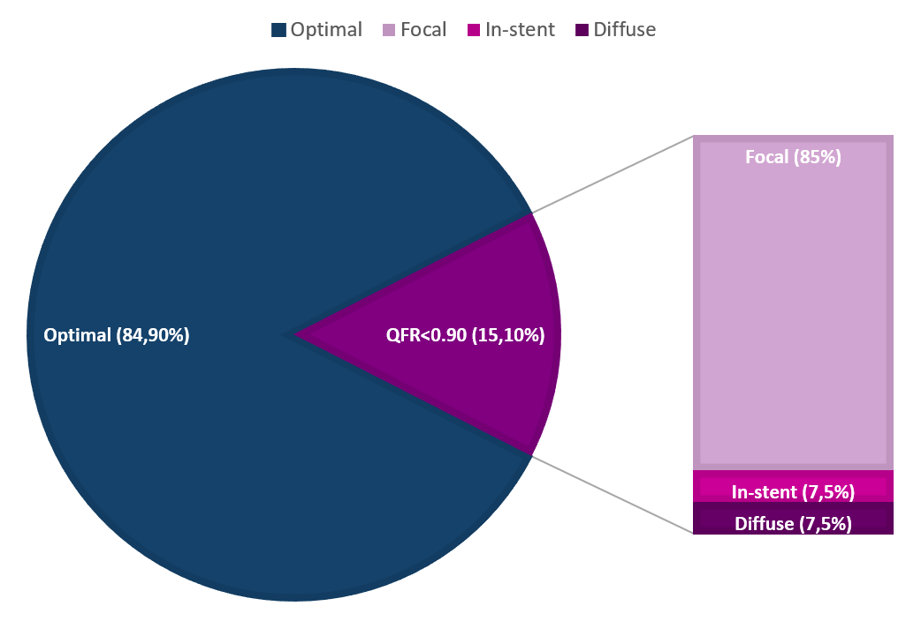
What are the essential results?
Angio-guided group: QFR post-PCI value & pattern
Secondary endpoints
 | Total | Angio-guided | Virtual PCI | p-value
Stent mm/lesion | 44.3 (21.6) | 46.1 (23.1) | 42.7 (20.1) | 0.07
Number of stent/patient | 1.5 (0.7) | 1.6 (0.7) | 1.4 (0.6) | 0.098
Procedure length | 71.5 (23.6) | 69.0 (23.1) | 73.9 (23.9) | 0.074
Contrast media | 184 (68) | 186 (67) | 182 (69) | 0.72
DAP | 5431 (2554) | 5350 (2211) | 5510 (2222) | 0.70
Troponin peak post-PCI | 1677 (2830) | 1825 (3167) | 1532 (2459) | 0.37
Creatinine peak post-PCI | 1.26 (0.8) | 1.30 (0.7) | 1.22 (0.7) | 0.29
Hospitalization length | 4.9 (3.1) | 4.8 (2.4) | 5.0 (3.6) | 0.44

Slide 9
Why is this important?
The AQVA trial demonstrated the superiority of a QFR-based virtual PCI plan versus a conventional angio-based approach in with regard to post-PCI optimal physiological result
The AQVA trial paves the way for future randomized clinical trials aimed at demonstrating the superiority of this approach over an angio-based strategy in terms of clinical outcome

Slide 10
The essentials to remember
Why?
No randomized data on QFR based virtual PCI plan
What?
Virtual PCI plan based on pre-PCI QFR versus angio-guided PCI
How?
Randomized clinical trial including 300 patients
What are the results?
Lower occurrence of post-PCI QFR <0.90 with virtual PCI
Why is this important?
AQVA trial paves the way for RCTs on clinical outcome

