Slide 1
Angio- or Microcatheter- Quantified FFR Virtual PCI versus Angio-guided PCI in the Achievement of an optimal post-PCI FFR
the AQVA II trial

Slide 2
Background
Attempts to demonstrate, in a randomized fashion, the superiority of incremental optimization guided by wire-based FFR have yielded conflicting results (1)
A procedural plan guided by angiography-derived FFR pullback has been investigated (2). This approach has proven feasible and superior to conventional angiography-based PCI, although limited to low anatomical complexity coronary lesions.
The implementation of pressure sensing microcatheters, along with the utilization of alternative hyperemic agent (such as papaverine), may facilitate the implementation of invasive-physiology procedural planning and guidance.
1. Eur Heart J. 2021;42:4656-4668. 2. JACC Cardiovasc Interv 2023;16:783–94.
Notes:
The FIRE trial is focused on a peculiar and neglected population, namely older patients with myocardial infarction and multivessel disease: Why? Because:
1. they are poorly represented in conventional trials being less than 10% of the overall study populations.
2. The risk of periprocedural complications is higher and prognostically impactful in older patients.
3. While there is no doubt in pursuing a complete revascularization in a patient aged around 60, recent data questioned the same approach for older patients (over 75).

Slide 3
Aims
To demonstrate the superiority of the physiology-based PCI over conventional angiography-based PCI in achieving an optimal post-PCI outcome, as assessed by invasive post-PCI FFR
To test the non-inferiority of angiography-derived FFR compared to microcatheter-derived FFR guidance for PCI
Notes:
The present is a prespecified analysis of the FIRE trial aiming to i) describe the frequency and prognostic impact of HBR status, ii) investigate the comparative efficacy and safety outcomes across HBR status of physiology-guided complete revascularization versus culprit-only strategy.

Slide 4
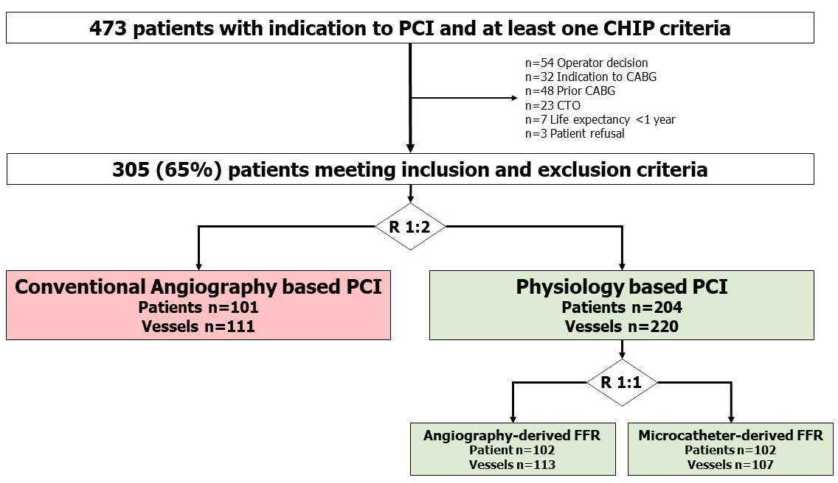
Design
Multicenter, open-label, investigator-driven, randomized, controlled, parallel group clinical trial
Sample size superiority
Physiology-based PCI: 50% increase in the occurrence of the primary endpoint.
2:1 randomization: 270 patients (180 in the physiology-based PCI group and 90 in the angiography-based group), in order to demonstrate an increase in the percentage of patients with FFR values>0.86
80% statistical power
significance level of 2.5%
Sample size non-inferiority
SD of the post-PCI FFR in the TARGET-FFR trial =0.08, a non-inferiority limit was set at -0.032
1:1 randomization: 198 patients (99 patients for each subgroup) were required to demonstrate with 80% power, that the lower bound of a one-sided 97.5% confidence interval would be above the non-inferiority margin.
In conclusion, at least 300 patients were needed for the study, with 200 in the physiology-based PCI group and 100 in the conventional angiography-based PCI group.
Randomization was stratified by center, clinical presentation (ACS vs. CCS) and study vessel (LM - LAD vs. other than LM-LAD).
www.clinicaltrials.gov, NCT05658952
Notes:
Patients could be randomized within 48 hours after the successful treatment of the culprit lesion to either a physiology guided complete revascularization or to a culprit only treatment. Complete revascularization had to be obtained during index hospitalization. The follow-up was performed at 1, 3 and 5 years. We report today the primary endpoint results at 1 year. The sample size of the trial was around 1400 patients.

Slide 5
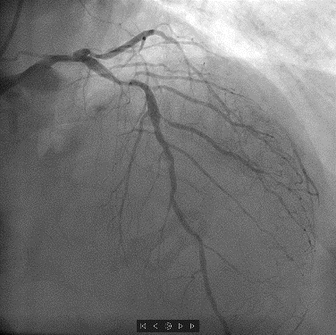
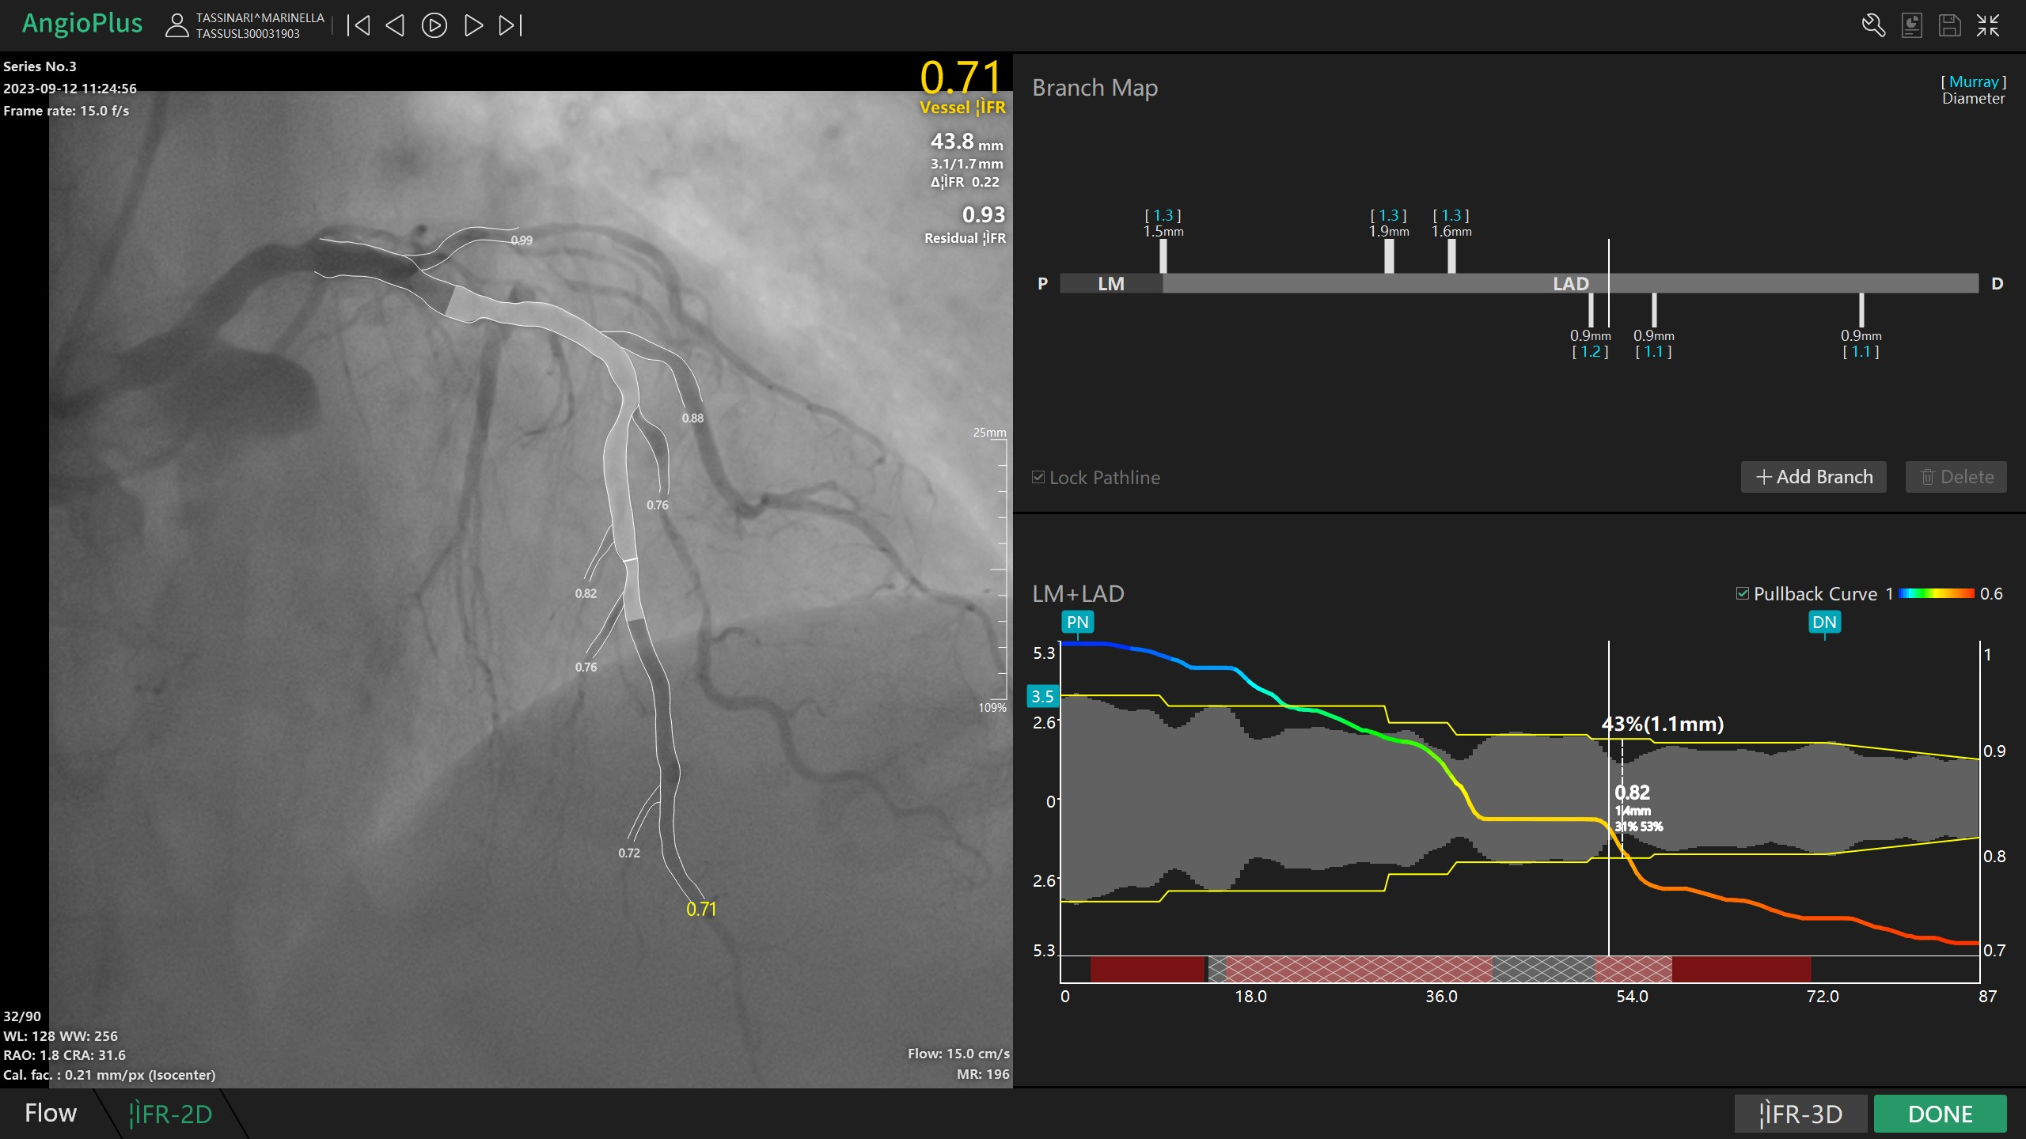
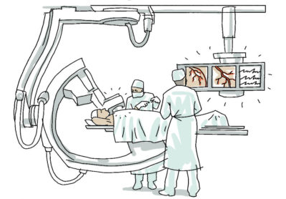
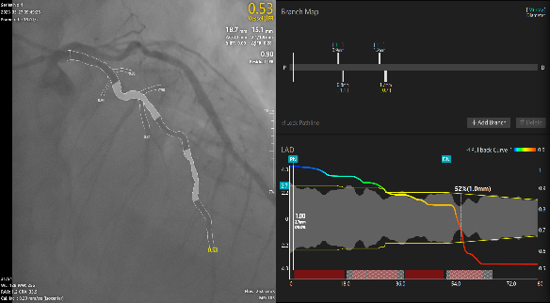
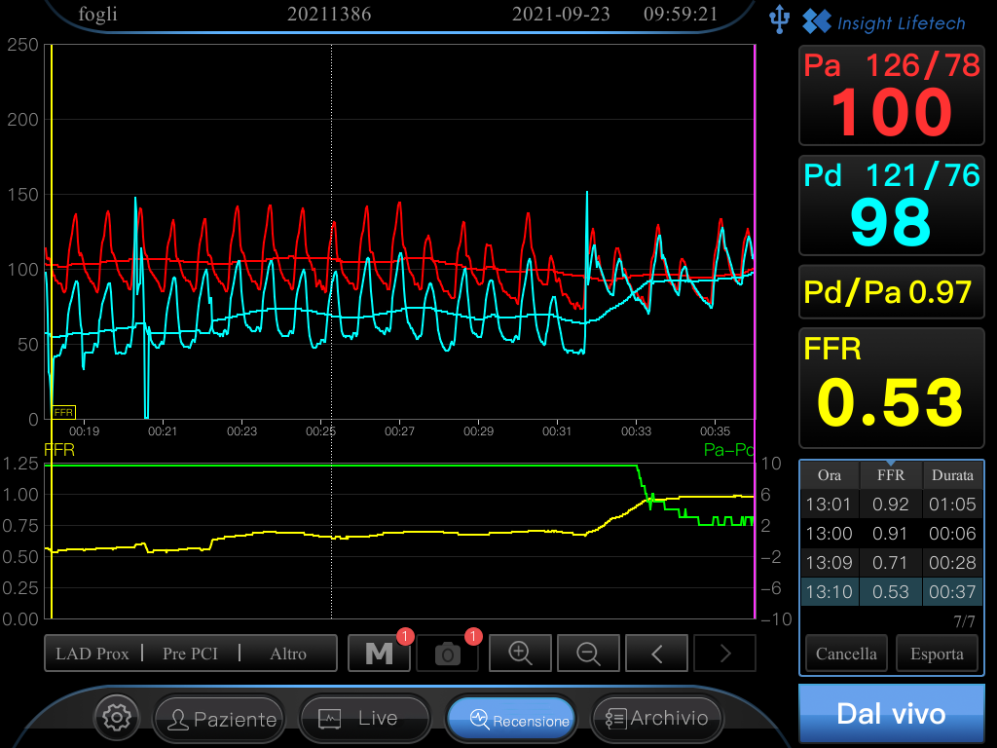
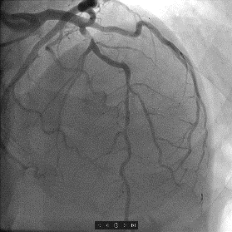
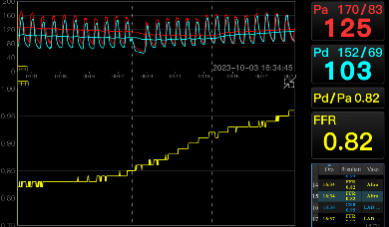
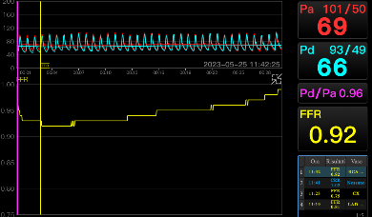
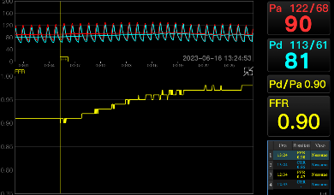
Coronary Physiology, PCI & Stent
Angiography-based
Angiography FFR
Microcatheter FFR
PCI with biodegradable polymer sirolimus eluting ultra thin stent (Supraflex Cruz)
Primary Endpoint: Post-PCI FFR

Slide 6
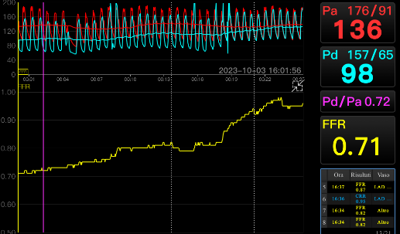
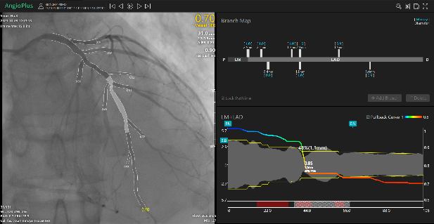
Microcatheter Virtual PCI
TruePhysio (Insightful)
Angiography FFR Virtual PCI
Angioplus (Pulse)
Pre-PCI Pullback
Pre-PCI Pullback

Slide 7
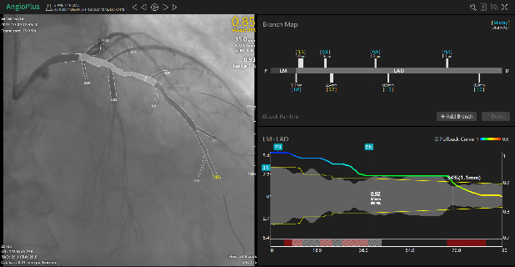
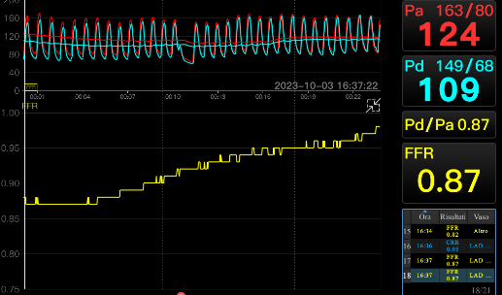
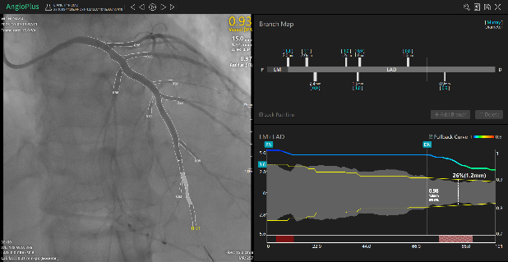
Microcatheter Virtual PCI
TruePhysio (Insightful)
Angiography FFR Virtual PCI
Angioplus (Pulse)
Pre-PCI Pullback
Pre-PCI Pullback
Post-PCI Pullback Focal Drop
Post-PCI Pullback Focal Drop
Final Pullback
Final Pullback

Slide 8
Endpoints
Primary – Superiority Physio vs Angio
Post-PCI FFR>0.86
Primary – Non-inferiority Angio- vs Micro-derived FFR
Post-PCI FFR
Secondary
Procedure duration & Contrast
Notes:
The primary endpoint was the patient composite endpoint of all-cause death, any myocardial infarction, any stroke, or ischemia-driven revascularization.
The key secondary endpoint was the composite of cardiovascular death or myocardial infarction.
The safety endpoint was the composite of contrast-associated acute kidney injury, stroke, or major bleeding according to the BARC classification.
Other secondary endpoints were all the component of the primary and key secondary endpoint.

Slide 9
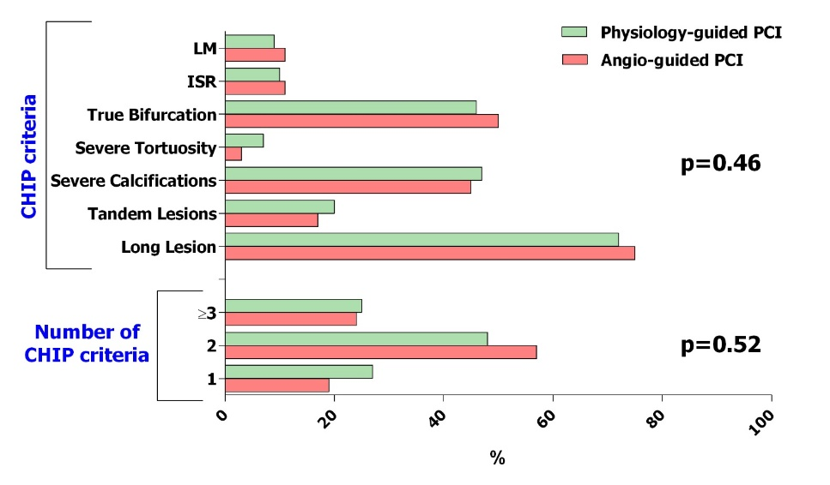
Baseline Characteristics
No differences between physiology groups
Characteristic | Angiography-based (n=101) | Physiology-based (n=204) | p-value
Age, years | 70 [61-78] | 70 [62-76] | 0.60
Male sex | 82 (81) | 152 (75) | 0.25
Medical History
Hypertension | 80 (79) | 152 (75) | 0.40
Dyslipidemia | 80 (79) | 148 (73) | 0.26
Diabetes | 27 (27) | 58 (28) | 0.79
Smoker | 29 (29) | 42 (21) | 0.12
Prior MI | 14 (14) | 34 (17) | 0.62
Prior PCI | 25 (25) | 47 (23) | 0.78
COPD | 9 (9) | 12 (6) | 0.34
CKD* | 34 (34) | 58 (28) | 0.36
PAD | 17 (17) | 42 (21) | 0.54
Clinical presentation
STEMI | 25 (24) | 58 (28)
NSTEMI | 22 (22) | 34 (17) | 0.21
CCS | 55 (54) | 113 (55)
CHIP criteria
Notes:
Baseline characteristics were comparable between the two groups.
Median age was 80 years, almost 20 years higher than in previous trials as a consequence of the inclusion criteria.
The rate of female patients was higher than in prior trials being 36% when the usual rate of female in previous studies was around 20%.
Again, please note that both STEMI and NSTEMI were included as long as a culprit lesion was clearly identifiable.
In the FIRE trial population, 65% of patients were hospitalized for a NSTEMI.

Slide 10
Vessels Characteristics
No differences between physiology groups
 | Angiography-based (n=111) | Physiology-based (n=220) | p-value
Target vessel, no. (%)
LM | 8 (7) | 13 (6) | 0.90
LAD | 70 (63) | 139 (63)
LCx | 14 (13) | 32 (15)
RCA | 19 (17) | 36 (16)
Quantitative coronary analysis
RVD, mm | 3.25±0.37 | 3.22±0.42 | 0.57
%DS | 80 [70-90] | 82 [74-90] | 0.11
Lesion length, mm | 30 [20-40] | 31 [22-40] | 0.13
 | Angiography-based (n=111) | Physiology-based (n=220) | p-value
Procedural details
Predilation, no. (%) | 101 (100) | 204 (100) | 0.97
Nr of stents | 1 [1-2] | 1 [1-2] | 0.46
1 | 61 (55) | 137 (62)
2 | 39 (35) | 54 (26) | 0.17
3+ | 11 (10) | 23 (11)
Total stent length, mm | 40 [28-56] | 36 [24-56] | 0.32
Stent diameter | 3.5 [3-3.5] | 3.5 [3-3.5] | 0.28
Postdilation | 110 (99) | 213 (97) | 0.27
Imaging | 42 (38) | 68 (31) | 0.20
Notes:
Baseline characteristics were comparable between the two groups.
Median age was 80 years, almost 20 years higher than in previous trials as a consequence of the inclusion criteria.
The rate of female patients was higher than in prior trials being 36% when the usual rate of female in previous studies was around 20%.
Again, please note that both STEMI and NSTEMI were included as long as a culprit lesion was clearly identifiable.
In the FIRE trial population, 65% of patients were hospitalized for a NSTEMI.

Slide 11
Primary Endpoint
Physiology vs Angiography
Percentage
Notes:
11

Slide 12
Secondary Endpoint
Physiology vs Angiography
 | Angiography (n=101) | Physiology (n=204) | p-value
Pd/Pa | 0.93 [0.91-0.96] | 0.95 [0.93-0.97] | <0.01
Resting index | 0.92 [0.89-0.94] | 0.93 [0.92-0.96] | <0.01
FFR | 0.87 [0.83-0.90] | 0.90 [0.88-0.92] | <0.01
200
190
P=0.99
P<0.01
100
180
90
170
80
160
70
Contrast media
Procedure length
150
60
140
50
130
40
120
Angio
Physio
110
Angio
Physio
Notes:
12

Slide 13
Primary Endpoint
Microcatheter- vs Angiography-derived FFR
Percentage
Notes:
13

Slide 14
Secondary Endpoint
Microcatheter- vs Angiography-derived FFR
 | Angiography-derived FFR (n=102) | Microcatheter-derived FFR (n=102) | p-value
Pd/Pa | 0.95 [0.94-0.97] | 0.94 [0.93-0.96] | 0.19
Resting index | 0.93 [0.90-0.96] | 0.93 [0.91-0.94] | 0.65
FFR | 0.89 [0.87-0.93] | 0.89 [0.86-0.91] | 0.38
P=<0.01
30
29%
20
Multiple physiology measurements %
10
0
5%
Microcath
FFR
Angio
FFR
Notes:
14

Slide 15
Secondary Endpoint
Microcatheter- vs Angiography-derived FFR
 | Angiography-derived FFR (n=102) | Microcatheter-derived FFR (n=102) | p-value
Pd/Pa | 0.95 [0.94-0.97] | 0.94 [0.93-0.96] | 0.19
Resting index | 0.93 [0.90-0.96] | 0.93 [0.91-0.94] | 0.65
FFR | 0.89 [0.87-0.93] | 0.89 [0.86-0.91] | 0.38
190
P=<0.01
P=<0.01
180
100
170
90
160
80
150
Procedure length
Contrast media
70
140
60
130
50
120
Microcath
FFR
Angio
FFR
Microcath
FFR
Angio
FFR
Notes:
15

Slide 16
Limitations
Generalizability
Physiology discriminative ability to detect stent underexpansion (1)
Microcatheter-derived FFR was utilized as standard to demonstrate angiography-derived FFR non-inferiority even if the amount of supporting data is lower compared to wire-based physiology
1. JACC Cardiovasc Interv 2023;16. Doi: 10.1016/J.JCIN.2023.03.044.
Notes:
In conclusion, among patients aged 75 years or older with MI and multivessel disease, physiology-guided complete revascularization was associated with a lower occurrence of the composite of death, MI, stroke, or ischemia-driven revascularization as well as of the composite of CV death or MI compared to a culprit-only revascularization strategy.

Slide 17
Conclusions
Coronary physiology is superior to conventional angiography in guiding and optimizing PCI procedures in patients undergoing CHIP, particularly in terms of invasive post-PCI FFR values.
Both physiology approaches, namely angiography- and microcatheter-derived FFR, were equally effective.
Notes:
In conclusion, among patients aged 75 years or older with MI and multivessel disease, physiology-guided complete revascularization was associated with a lower occurrence of the composite of death, MI, stroke, or ischemia-driven revascularization as well as of the composite of CV death or MI compared to a culprit-only revascularization strategy.

